Slide 1
Customer Services Group UK
February 2021
Maria Carnegie: Head of Customer Services
Rachel Harding: Asst Customer Services Manager
Lewis Dean: Security Manager
Notes:
Hello - introductions

Slide 2
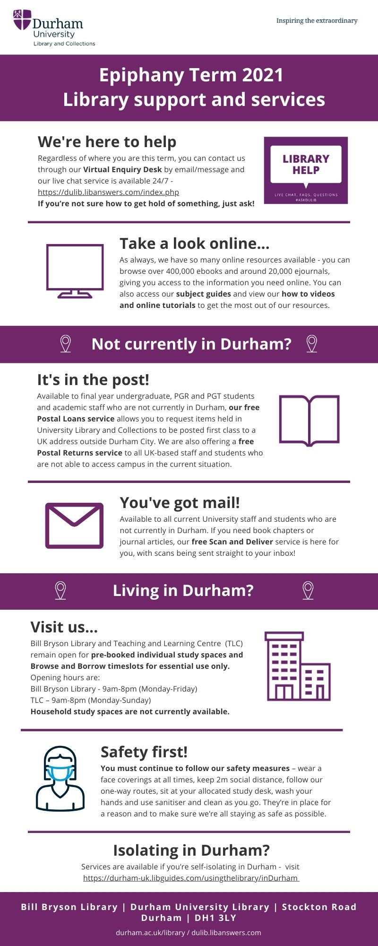
What we did
Reduce opening times
Reduce study spaces
Pre-booked access only
Notes:
We did all the things you don’t want to do as a library service -

Slide 3
Anticipated issues relating to behaviours
Queues / entry
Not following guidance
Staff expectations

Slide 4
Different spaces
Main Library
Covid Marshal presence
Generally very good. Most common issue is around use of study spaces
Teaching & Learning Centre
Covid Marshal presence
Some conflict with other staff trying to manage behaviours
Unsupervised study space
Reports of students not wearing facemasks, sitting too close, etc
Covid Marshal arranged for January
Local Hotel
No University staff presence
Hotel staff generally checked once an hour. No reports of issues for hotel staff

Slide 5
Covid Marshals

Slide 6
Mitie & Covid Marshals
Provide Uni security, including overnight staffing for Library
Mostly existing staff, some new recruits
Collaborative approach with Library
Regular reviews, feedback, development of SOP
Training: Marshal role different to security role

Slide 7
Negative behaviours
Students not sitting in the correct seat
Distancing
Household groupings
Individual study rooms…

Slide 8
Challenges and response to feedback
Covid Marshals – student feedback
35%, now 21% no-show rate for bookings
Availability of study spaces
Developed supportive approach

Slide 9
Timeline for use of Covid Marshals
Summer
October
December
January
February
Discussions
6 Marshals started, initially for 3 weeks
Not used over vacation
Increased Marshals in study spaces
Confirmed until end of academic year
Notes:
Library staff are hugely appreciative of having the marshal’s around.
We don’t experience a lot of negative behaviours, but they mean library staff can focus on library jobs, the marshals are there to be supporting, provide guidance and enforce when necessary.

Slide 10
Contact details
Maria Carnegie
maria.a.carnegie@durham.ac.uk
Home - Our services: Using the Library - Guides at Durham University (libguides.com)
Notes:
A

