Slide 1
Building a greater sense of belonging within the Library at University of Lincoln
Lesley Thompson Jemima Sims

Slide 2
‘Sense of belonging’
When students feel a sense of belonging, it can positively affect their motivation, academic success and well-being.
Four elements (Jackson 2022):
Connection – with peers, tutors and campus
Inclusion - accessibility, neurodiversity, access to resources, inclusive content and representation of staff
Support - Well-defined, clearly articulated, inclusive support systems and networks
Autonomy - empowered to makes choices about their learning and contributing to course content

Slide 3
Library ‘Sense of Belonging’
Working group – all library teams
Building on what we already do – study happy, wellbeing & fiction collection
Brainstorming ideas and best practice from other institutions
Multiple projects including student led
Family friendly study room
Study together
Events
Sensory room
New foyer design
Blog
Zines
Information Wall
Say my Name
Notes:
Staff volunteered

Slide 4
Family Friendly Study room
SU had asked us to look at this type of space as it was much requested
Increase in children on campus
Sector best practice – visit to University of York
Falls under connection & inclusion
Notes:
Add why we stopped and issues around H&S

Slide 5
Study together sessions
To combat loneliness by facilitating students working alongside others on similar tasks
Summer trial to assess demand and inform future sessions
Postgraduate Dissertation Writing and Pomodoro Technique sessions, not well attended and staff intensive
Future plans are to recruit students as facilitators and increase the types of session.
Ideas include:
General / Quiet / Neurodiverse
Presentation Creation / Presentation Practice / Reading
Dissertation Writing / Deadline Due / Revision / Getting Started or First Assignment / Editing
Falls under connection, support and inclusion
Notes:
No one attended – put some context

Slide 6
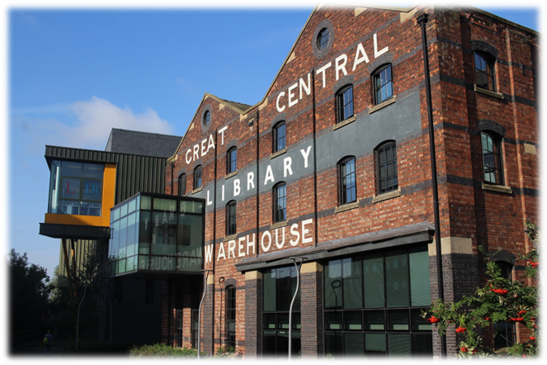
Diversifying Events
Past:
Held activities around Easter & Christmas – very popular
Started adding more of a cultural mix, representative of our student body
Falls under connection & inclusion
Now:
Collaboration with SU, Chaplaincy, Wellbeing, ResLife – coffee & cake, displays etc.
Focused on our core strength but invited others to use our space – ResLife game night, SU for bring & buy sale.
Monthly activity such as craft activities
More student led
Notes:
Update and add picture from ResLife

Slide 7
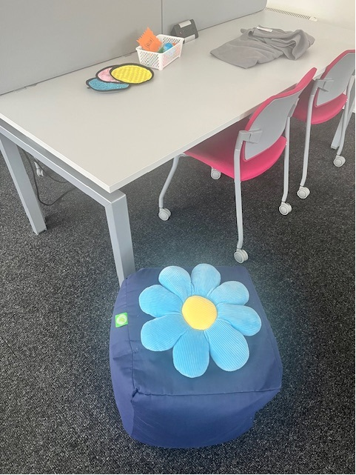
Sensory Room
This was a student led project, with the aim of creating a space that helped students mental health and was suitable for the neurodiverse community.
It includes sensory toys, alternative and comfortable seating, cushions and blankets, books and resources on mental health, tactile sensory pads and colouring pads and puzzles for relaxing
Notes:
Add picture and explain student led

Slide 8
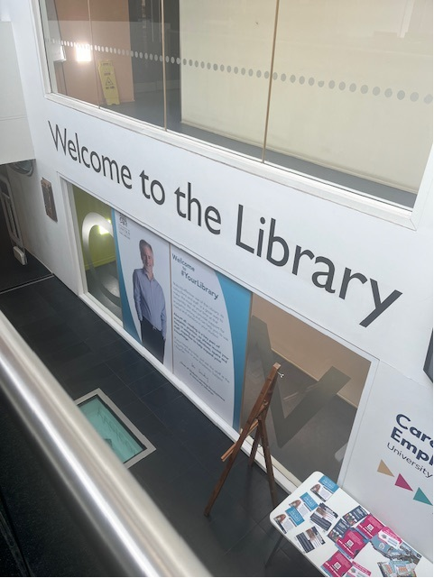
New foyer design
Current:
Picture of Director – not representative of student population
Needs a refresh
Falls under connection and inclusion
Next:
Student Competition
Brighter and more welcoming
Notes:
Explain competition issues with budget!

Slide 9
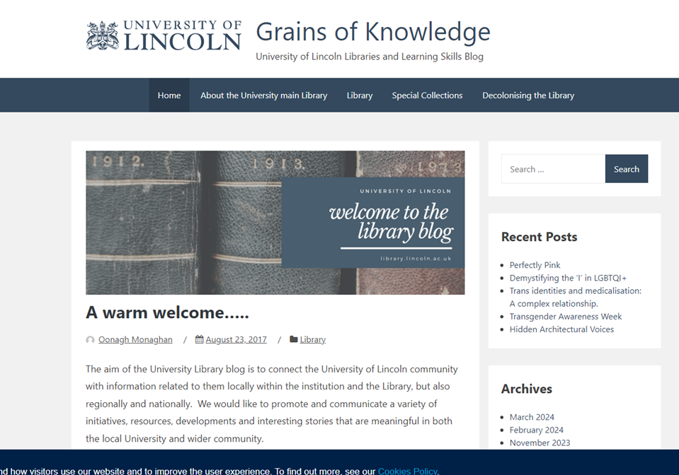
Library Blog
https://library.blogs.lincoln.ac.uk/
We have a University of Lincoln Libraries and Learning Skills Blog
The main aim is to raise awareness of all the Equality, Diversity and Inclusion activities that the library and its community are involved in, it’s a digital way of creating belonging.
The other aim is to connect the University of Lincoln community with information related to them locally within the institution and the Library, but also regionally and nationally.
Recent posts include work by Claire Arrand, our special collections librarian, our decolonisation group and LGBTQ+ awareness posts.
Notes:
Blog a digital way of creating sense of belonging

Slide 10
Zines
The Library is working to diversify materials and challenge white-centred, heteronormative practices impacting our collections, users, and services.
The Library and University are both committed to long term goals around decolonisation and equality, diversity, and inclusion (EDI) projects.
The aim of the zine collection is to be more representative of marginalised voices. Staff and students contribute via existing zine donations or student projects.
The Zine collection recently won an award from the University for Equality and Diversity, which we are very proud of.

Slide 11
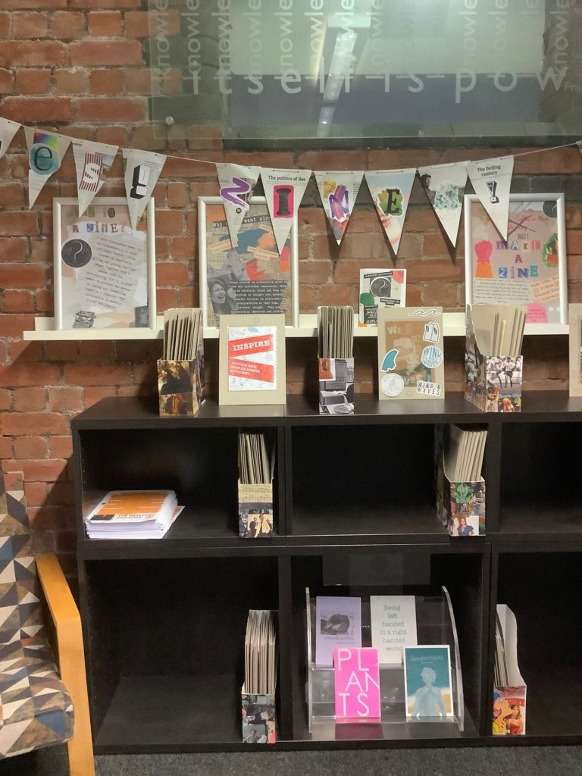
Zines Cont.
Why are they important?
They provide an alternative point of view – something is said by someone who wants to express it.
Producing a zine allows individual expression – no editorial board – simply a direct link to an individual’s opinion or artistic expression.
Zines provide an insight into today’s modern popular culture – a direct and unfiltered view of an individual’s interpretation at the time.
Historically important – letters were a principal form of communication but in our digital world, a lot of this type of history is disappearing. If we do not preserve zines, historians will have to write about our era from secondary sources.

Slide 12
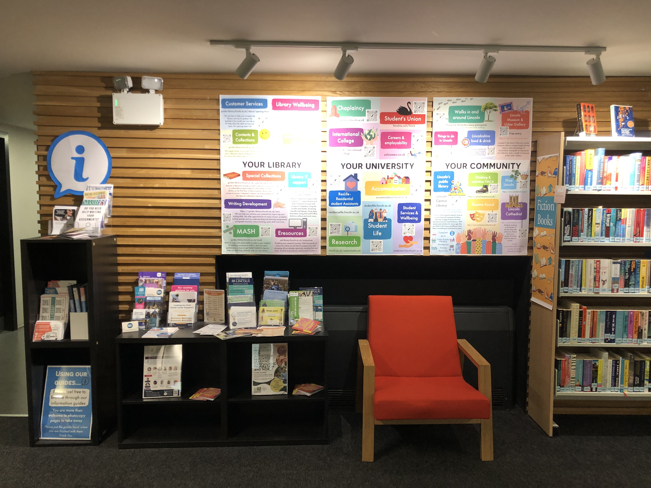
Information wall
To reduce exclusion that is created by having most information online only.
To fill a (possible) traditional expectation that the library will hold information about local services and events.
To be a central point for University information/signposting. To include information on:
University services – dedicated area for different services
External/local info
Public services
Local events’ what’s on’
Falls under connection, support and inclusion
Notes:
Add picture

Slide 13
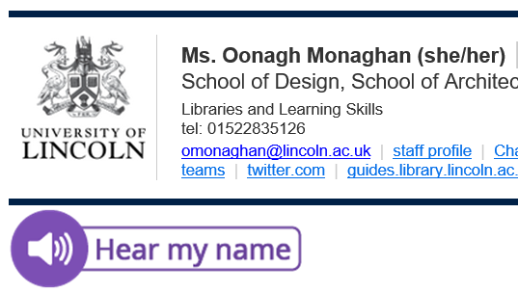
Say my name
Sector wide initiative – best practice from Nottingham Trent University
Creating a culture of inclusivity within a diverse learning community means developing practical skills and systems at both individual and institutional level.
This falls under inclusion and connection
This started last academic year.

Slide 14
Any questions?
Email: library@lincoln.ac.uk
Huge thanks to all in the Library Belonging Group: Sarah Lewis. Abi Woolley, Alexis Lamb, Phoebe Maris, Vicki Fairweather, Oonagh Monaghan. Eleanor Stanton & Daniel Grimshaw.

