Slide 1
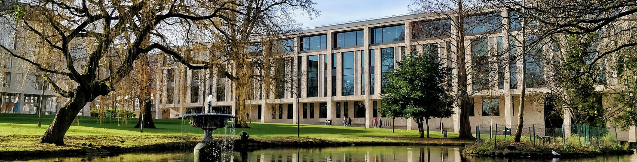
ROEHAMPTON UNIVERSITY LIBRARY
Getting Creative: How to engage with students on a shoestring budget

Slide 2
UNDERSTANDING
STUDENT LIBRARY EXPERIENCE AND REQUIREMENTS
1
Overall Experience
3
Library Access
2
Spaces and Services
4
Support
3
Engage with a diverse range of student groups and involve Student Union

Slide 3
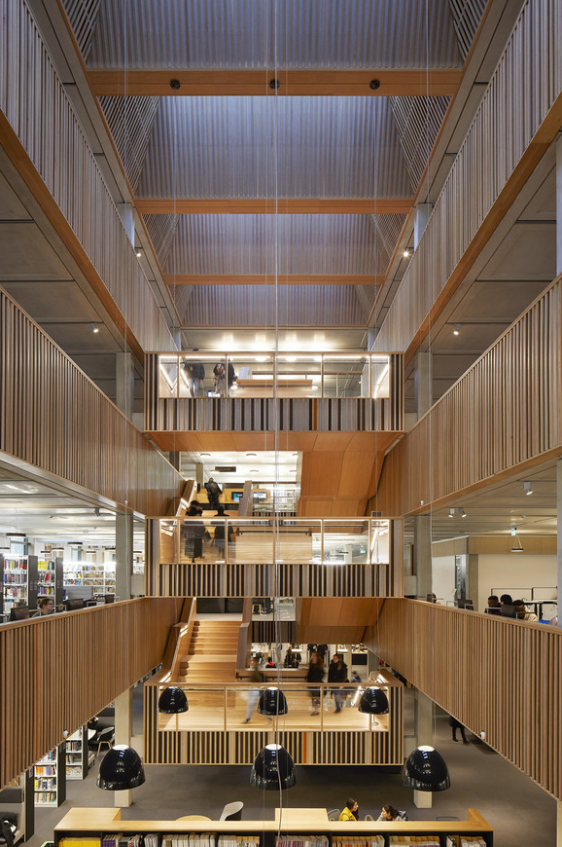
CHALLENGES
Low response on previous events
Hard to reach busy or disengaged students
Lack of incentives
RESOURCES
Time
Some freebies
Staffing
Creativity and a printer

Slide 4
ENGAGING STUDENTS
FUN / DIFFERENT
Colourful, themed, interactive
QUICK RESPONSE
Ballot boxes, stickers, post-its
FREEBIES
Tea and coffee, some freebies
WORTHWHILE
Meaningful to students, so worth their time

Slide 5
TIMELINE
Love Your Library
Whitelands Pop-Up
Focus Groups
Focus on what works and what we can improve
Focus on Study spaces
Focus group dates, in person and online
DEC
SURVEY
FEB
MAR
MAR
JAN
FEB
MAR
Whitelands Pop-up
Meeting with Student Union
If I ruled the Library ...
General Library Info
Focus on Study Spaces
Social Media polls
Whiteboard information

Slide 6
Pop-ups, Stalls, Polls
Love your Library
Vote for your study space
If I ruled the Library, I would...
Have I got a seat for You?
Social media polls
Whitelands campus events
Staffed/unstaffed
We used…
Coin counters, stickers,
shaped post-it notes, photos, whiteboards, craft and ingenuity.
Chatting while stirring the tea.

Slide 8
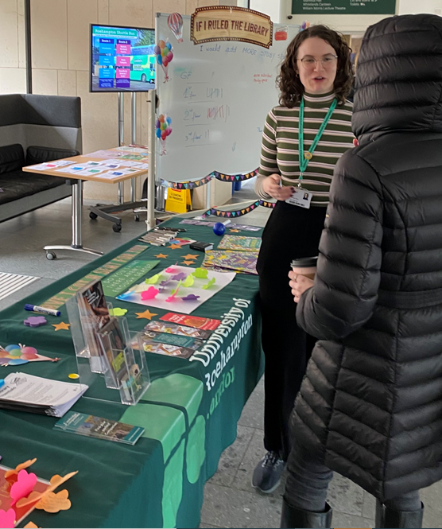
POP-UPS PAID OFF
373 comments
592 poll votes
Good understanding of study space needs
An overview of support and resource requirements
Events were enjoyable and fun to create
Created lots of opportunity for discussion
Collated responses were enough to show clear themes

Slide 9
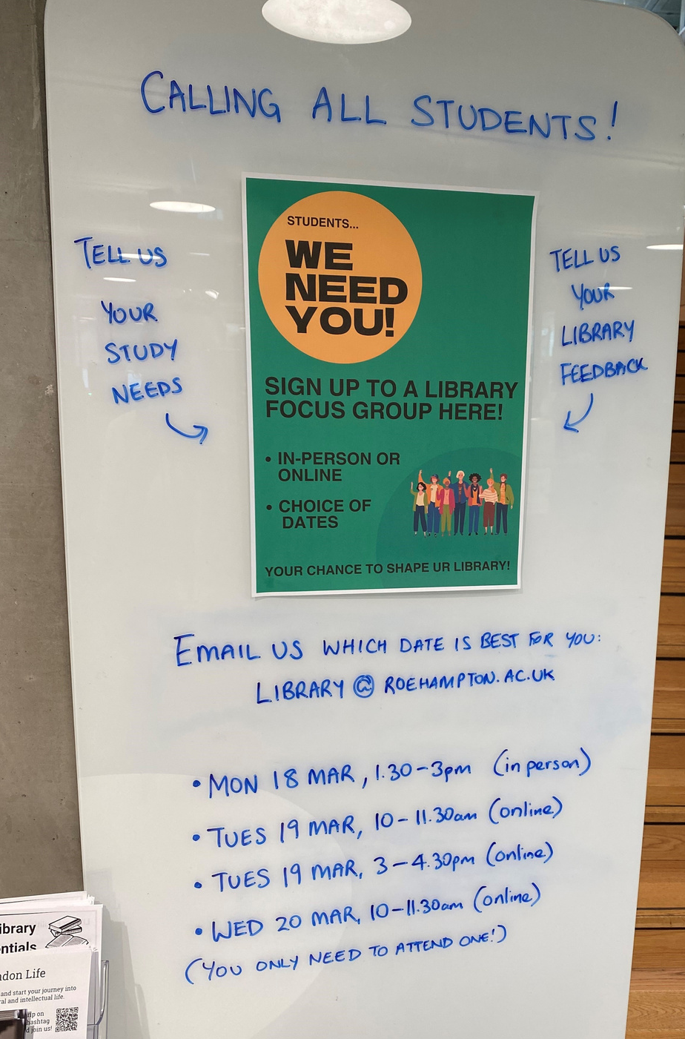
FOCUS GROUPS
Over 400 students initially agreed
Only 16 attended!
Initially, low response was disappointing but...
detailed
personal
insightful
meaningful
references to friends’ study habits
observations of other Library users
Information expanded outside those 16.

Slide 11
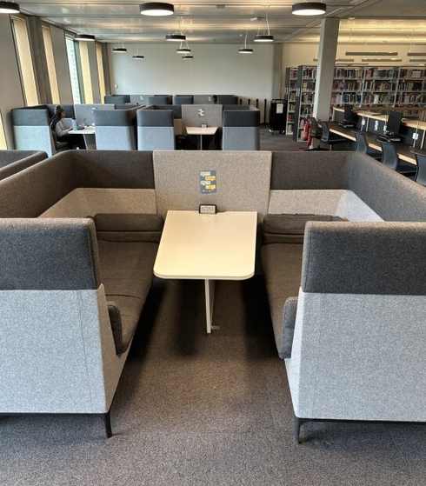
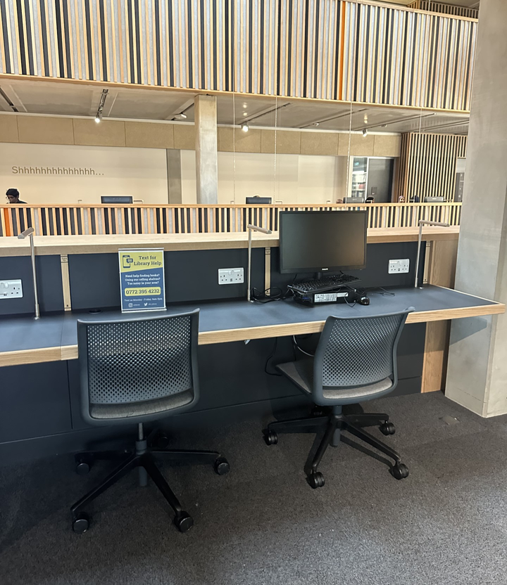
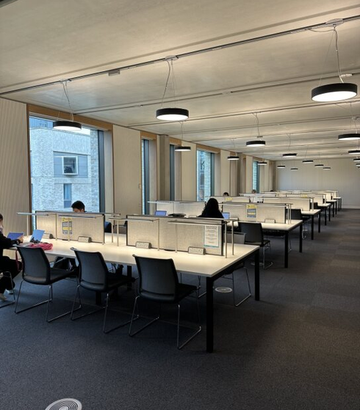
FOCUS GROUP LESSONS
Mixed bag due to low response
Engaged students ... engaged
Time consuming logistics
Incentives needed!
Good exercise
14 pages of relevant Library comments
Topped up the overall picture shaped by previous events
Great to have an opportunity to talk about Library life with students

Slide 12
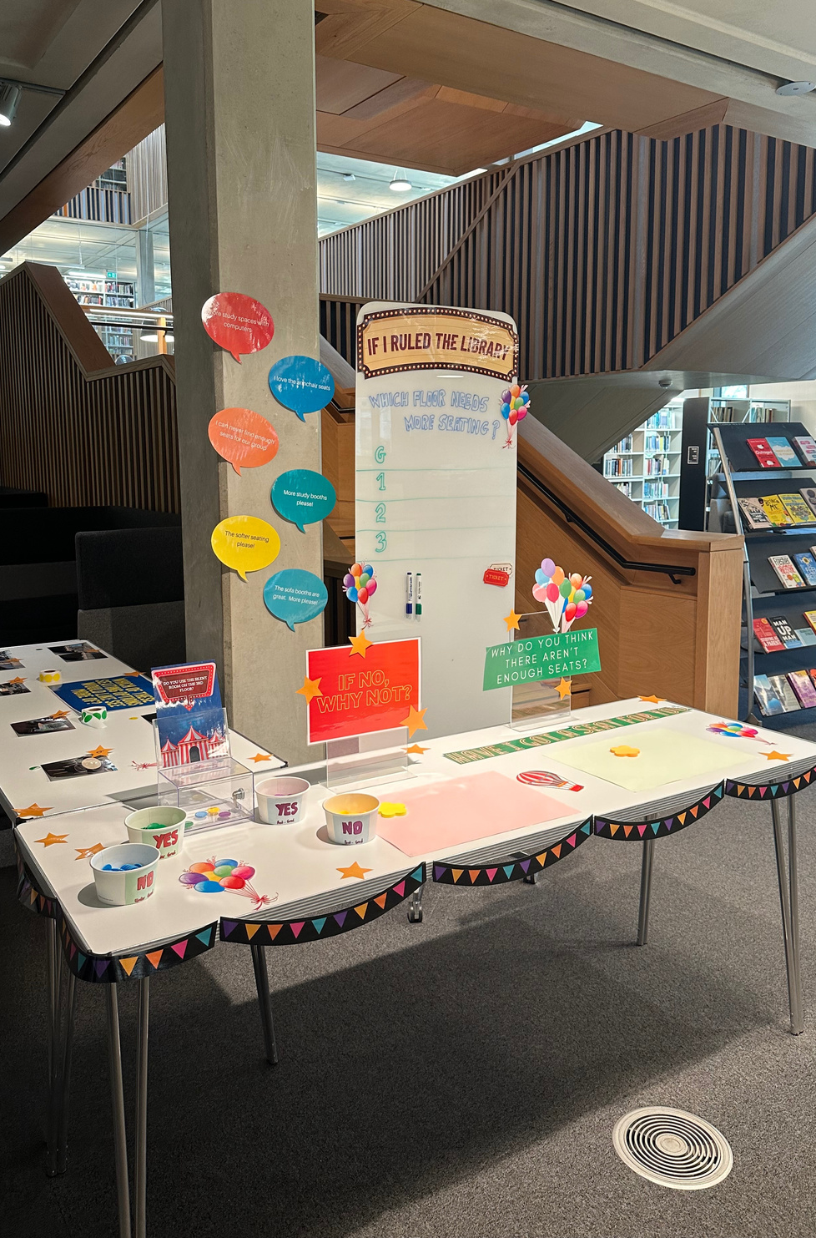
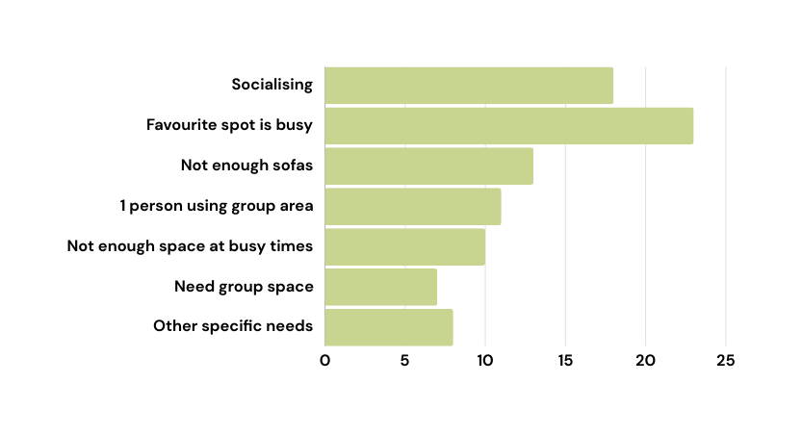
A sample of findings
Solving the study space mystery
Do we have enough study spaces?
422 votes - equal split. Additional 90 comments:
What we did after...
Increased soft seating
Rearranged existing furniture to create more group study
Changed noise zones - we split the library

Slide 13
Did it work?
Yes.
Staff and Time are valuable resources
Draw attention
Change location
Listen to the details
Keep it snappy
Build big picture from small events
Good exercise to stop, talk, rethink
Library was more ‘visible’

Slide 14
THANK YOU
Elena.kosmala@roehampton.ac.uk

