Slide 1
Student belonging and the library
Supporting student wellbeing at Charles Seale Hayne library
Claire Edwards – Service Operations Manager

Slide 2
Library and Academic Development Business Plan
Student learning environments: we will lead the vision of the future learning environment with stakeholder engagement to develop inspirational spaces to delight and inspire our increasingly diverse range of students and staff. Physical environments, critical to the student experience, inspire a sense of human belonging, wellbeing and affiliation as well as opportunities for new discoveries, collaborations and learning.
Notes:
The Library and Academic Development (LAD) business plan includes a student learning environments steer, and this has provided the direction and inspiration for the wellbeing spaces and incentives that we have introduced over the past few years.

Slide 3
What can the library do to help your wellbeing?
Notes:
What did they want?
Times Higher Education reported that 74% of students say their mental health has been negatively impacted by Covid. Something we ourselves had recognised. We are aware that the library is a safe place for our students and so we wanted to find out how we could truly support them by asking ‘what can the library do to help your wellbeing? ‘
We created a space within our entrance foyer on Mental Health Awareness Day to ask this question and we left the students to write their suggestions on flip chart paper in exchange for a sweet or two.
According to (La Rosa and Commodari, 2023) following the COVID-19 pandemic ‘It is essential to promote adequate university psychological services to support university students who have experienced the adverse psychological effects of the pandemic and enhance the resilience factors needed to improve their wellbeing in the post-pandemic period.’

Slide 4
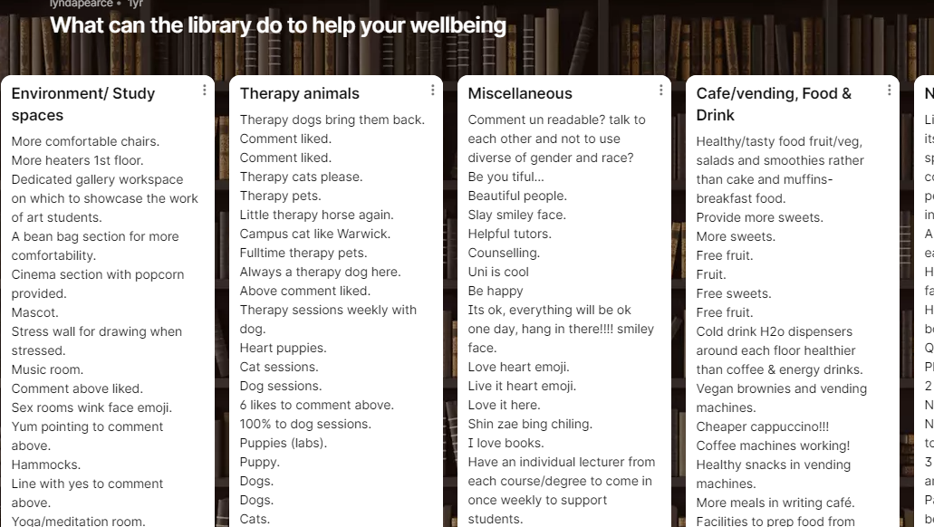
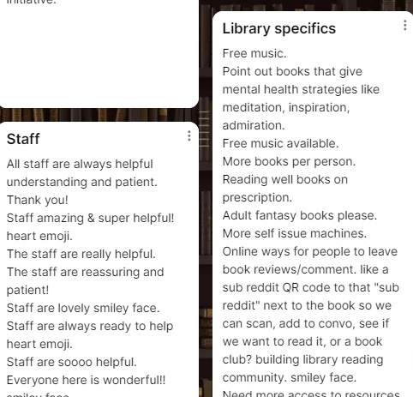
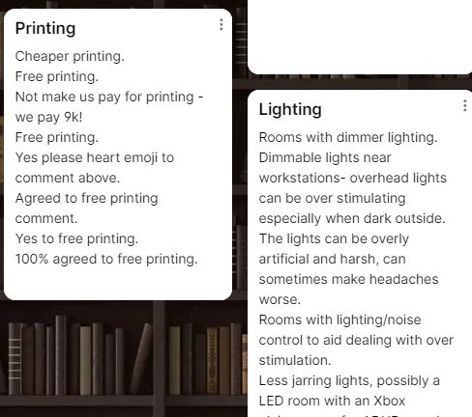
Notes:
What response did we get?
This engagement provided us with hundreds of comments which we were then able to theme and helped guide us with our next steps.

Slide 5
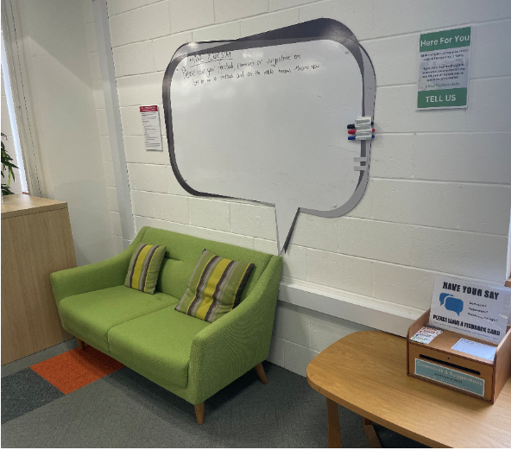
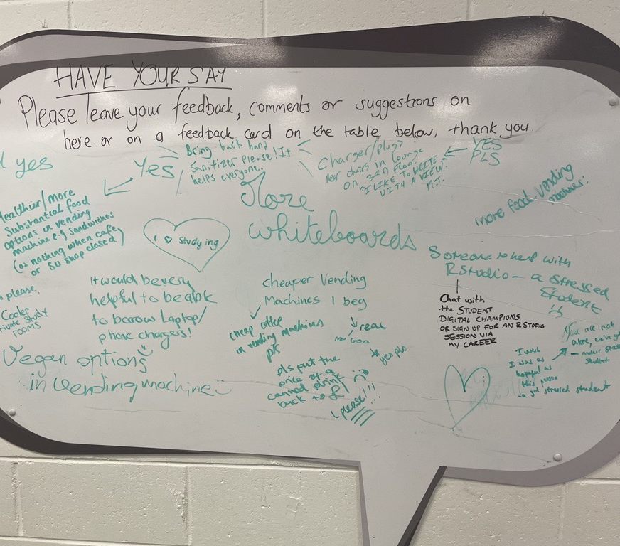
Open feedback board and comment card box
Notes:
We have an ongoing a feedback board and comment card box available to students and have felt this feedback has been a great way to ignite thoughts, however the added comments from the wellbeing engagement really helped us to understand the true needs of he students.

Slide 6
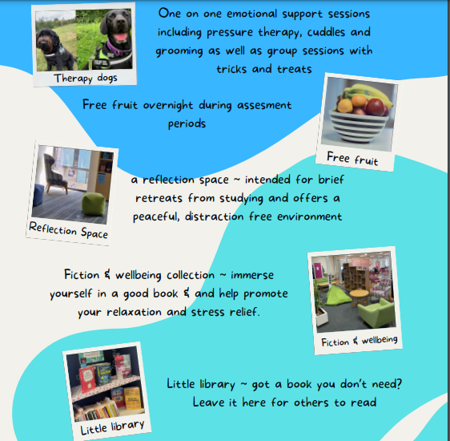
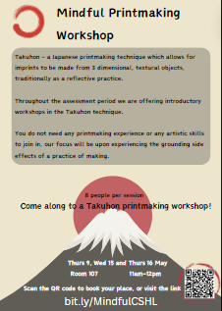
Our initiatives and spaces
Notes:
What have we done?
Over the past few years we have introduced:
Therapy dogs
Free fruit
Printing workshops
Little library
Fiction and wellbeing collection
Reflection space
Menopause reading list

Slide 7
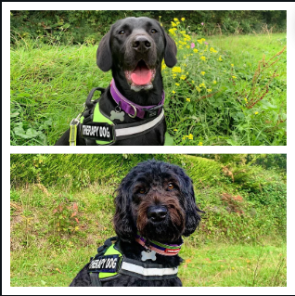
Bales buddies – Therapy dogs
Group sessions with Arthur who is excellent at agility, loves to play and show off, doing tricks and treat boards.
1 on 1 sessions with Grace, who is an emotional support dog who does deep pressure therapy, cuddles and grooming .
Notes:
Bales buddies
This is our most anticipated event. We have visits 3 times a year, during arrival week as a meet and a greet (especially comforting for those students who have just left their pet at home for the first time) and again during both assessment periods offering a choice of a 10 minute prebooked 121 and group sessions. People with allergies are directed towards the dog Grace as her breed is hypoallergenic.

Slide 8
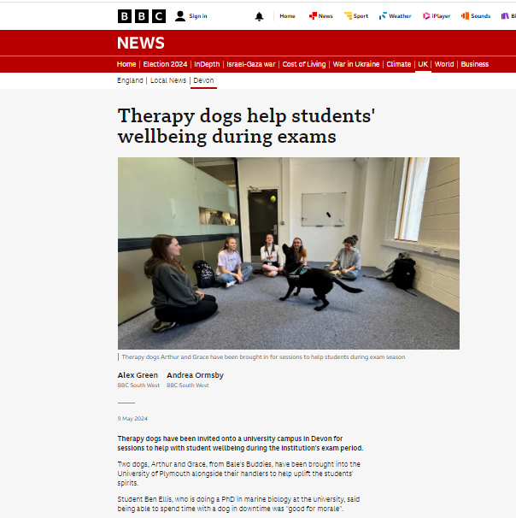
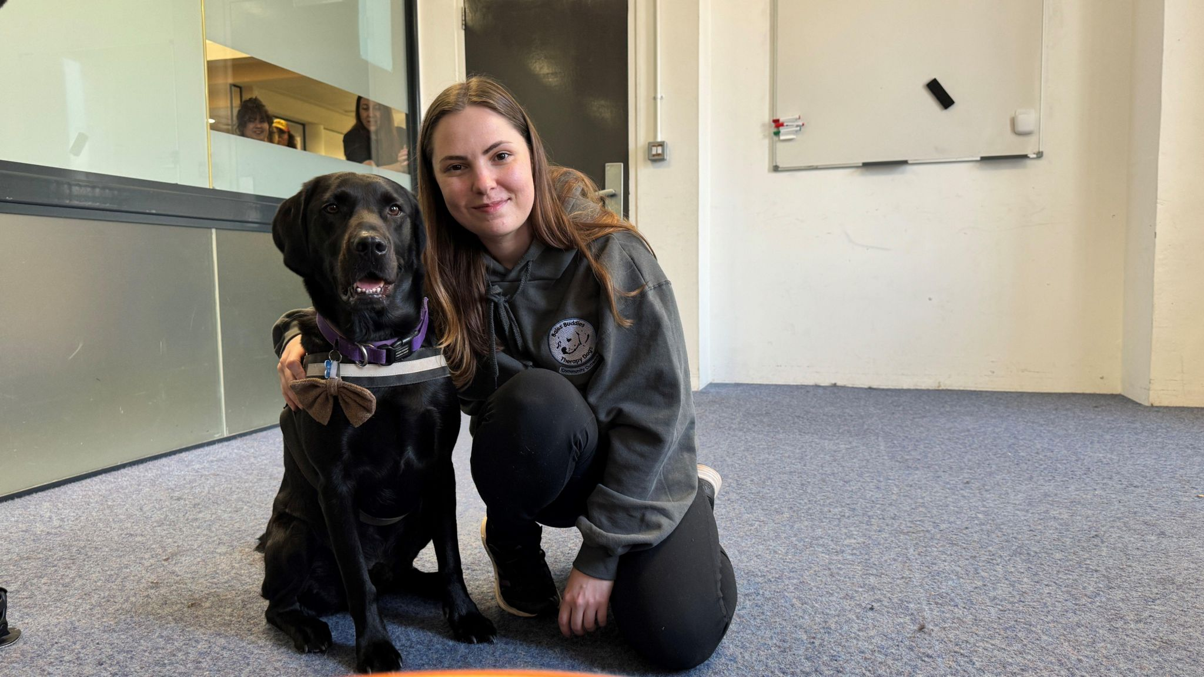
Bales buddies – Therapy dogs
This year we made it onto the local BBC website and evening news.
Notes:
Bales buddies
This year we created quiet an interest and our sessions during May were shared in the local media. This also has a positive impact of the wellbeing of staff at the library and at Bales buddies. It made them proud and excited to be involved in something that the students quoted as being ‘’comforting’’ and ‘’I mean they’re so happy, so it rubs off on you’’

Slide 9
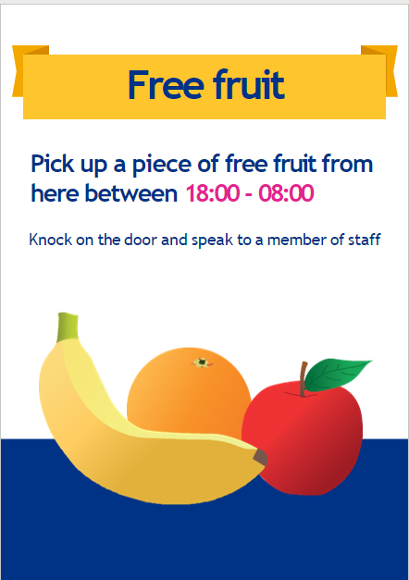
Free fruit incentive
Notes:
Free fruit
To support our study breaks promotion during assessment period we offered limited free fruit to students. They must physically collect the fruit from the staff reception desk. This encourages a break in study, some movement and an opportunity for our team to check in on their wellbeing. As this is offered overnight it also gives some engagement to our lone working team members.

Slide 10
Takuhon - Printing For Mindfulness
Notes:
This May was our first time offering some printing workshops. This is a form of printing which allows for flat images to be made from physical 3D objects, it is often used in mindfulness practice. We offered two sessions.
These session were led by one of our team who is a qualified art teacher and currently studying a PHD in printmaking.
As a thank you to the team for their hard work this year we have been able to schedule a session with Bales Buddies and two printing workshops, one of which was outside in the reservoir gardens on campus. Everyone’s wellbeing is important to us.

Slide 11
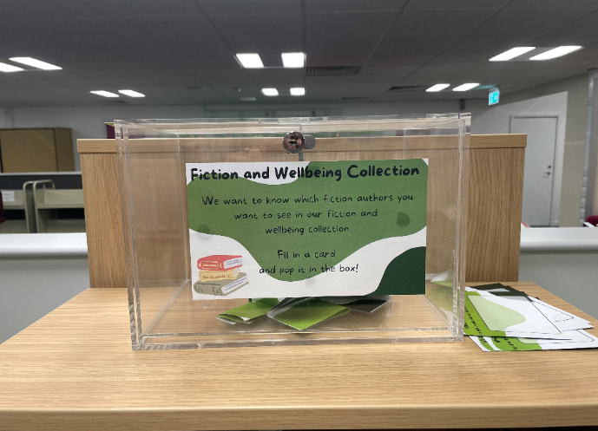
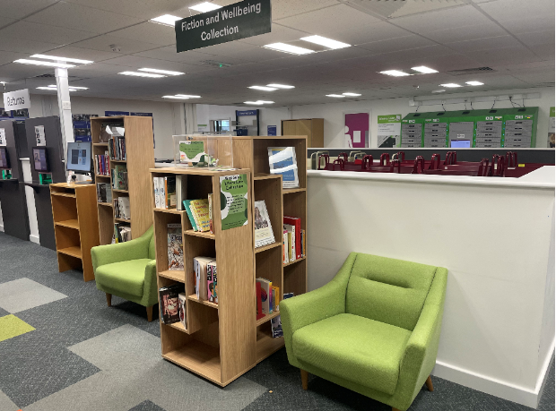
Fiction & wellbeing collection
Notes:
Fiction and Wellbeing collection
Students were asking us for some time for a fiction collection, but budgets were allocated for academic reading. We realised that we needed to break down this barrier and introduce a dedicated space to take breaks away from study, to read for pleasure, aiding stress relief and relaxation.
We also have a suggested author box in this space to help us build the fiction and wellbeing book collections.

Slide 12
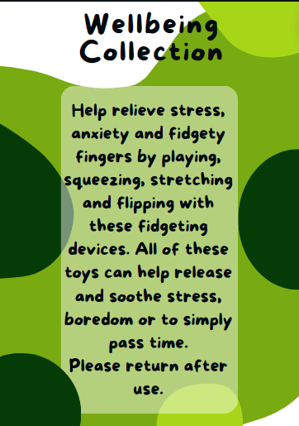
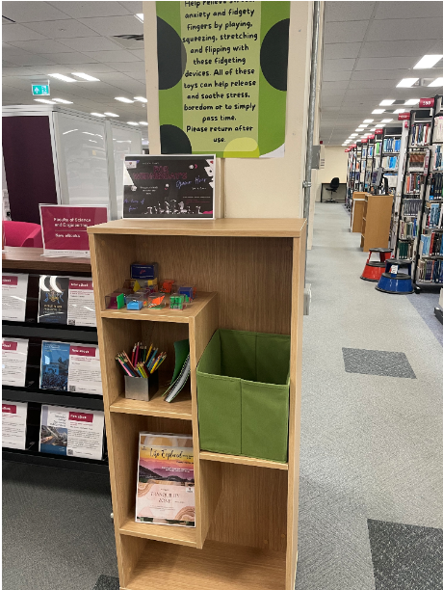
Fiction & wellbeing collection
Notes:
The F&W space also includes some fidget toys, colouring in books to help relieve stress and anxiety. We also use space within the shelves to promote other wellbeing events held within the university, specifically events organised by Pastoral Support Services.

Slide 13
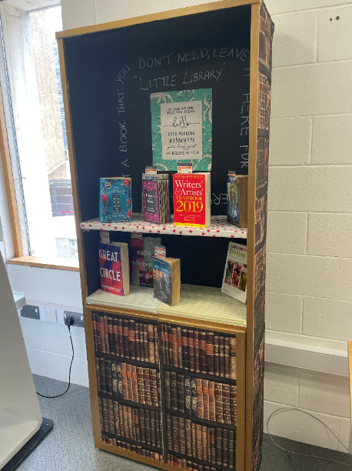
Little library and love letters
Notes:
We know we are seen as a safe space and this letter from ‘a book lover girl from Iran’ captures this wonderfully. This is one of many love and break up letters that we did as an engagement on February 14th, as an incentive for taking part they could take a free book from our new ‘little library’ which was also introduced on this day and remains in use at the entrance foyer. This encourages reading for pleasure outside of the library.

Slide 14
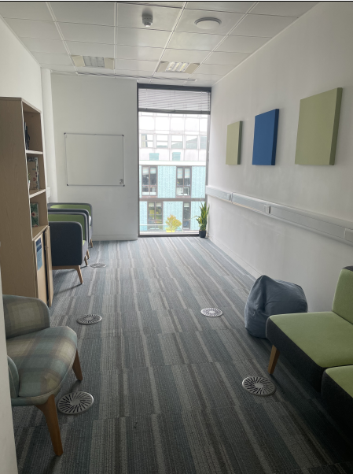
Notes:
This is our proudest achievement and a longtime coming. There are two spaces within one room sectioned with a patrician wall. This is a quiet space with no electronic equipment, signage or study. It is a shared space with lots of natural lighting and low comfy furniture.

Slide 15
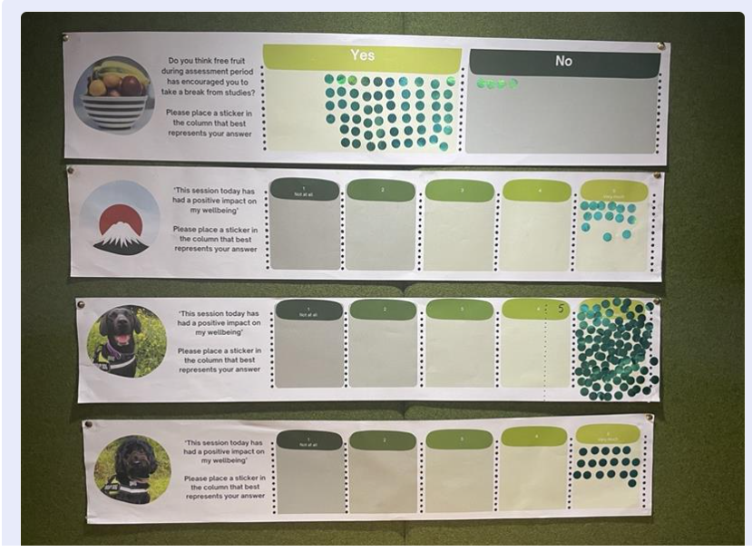
Measuring impact
Notes:
This year we have started to measure the impact of our incentives, to demonstrate that we are having a positive impact on student wellbeing. Here are some examples of how we have done this.

Slide 16
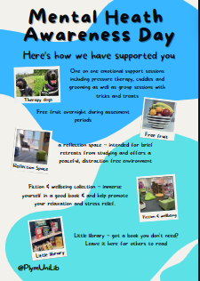
Notes:
We use the opportunity on mental health awareness day to promote how we have supported students and to invite more feedback on how we can support their wellbeing in the future.

Slide 17
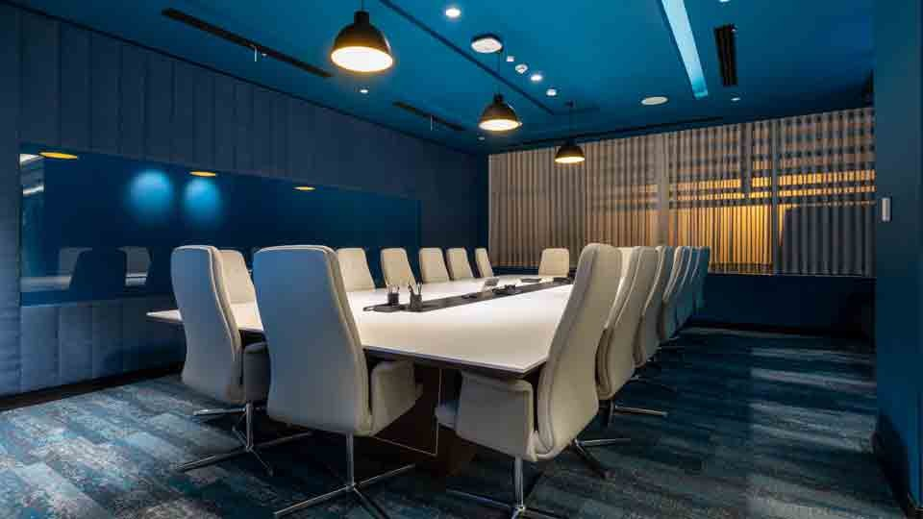
What’s next
Notes:
With regards to the physical environment, we want to start exploring spaces that support neurodivergent students and staff. A way to produce a creative and appealing lighting scheme that doesn’t distract or cause discomfort, spaces where lighting and noise can be controlled, increased and more appealing individual study spaces.
To bring all together all our initiatives including reading lists we have created we are going to produce and put together a wellbeing lib guide.

Slide 19
References
La Rosa, V.L. and Commodari, E. (2023). University Experience during the First Two Waves of COVID-19: Students’ Experiences and Psychological Wellbeing. European Journal of Investigation in Health, Psychology and Education, [online] 13(8), pp.1477–1490. doi:https://doi.org/10.3390/ejihpe13080108.

